Slide 2
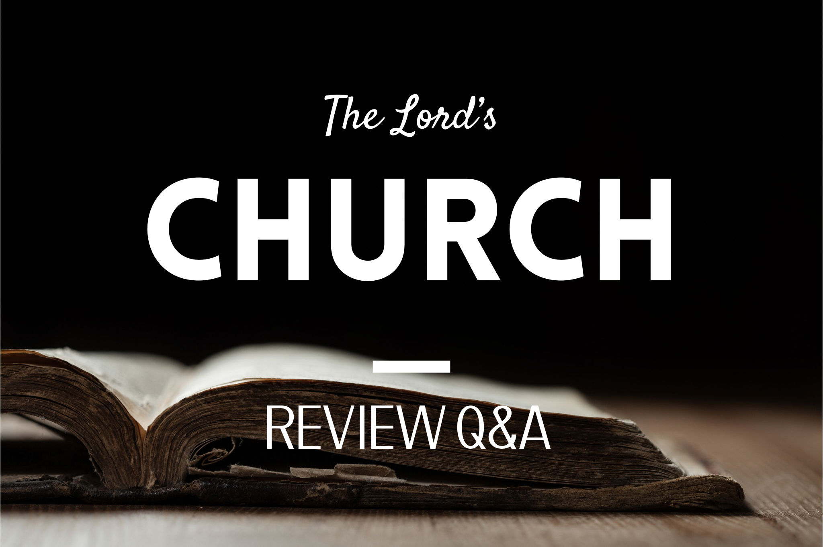

Slide 3



What’s the difference between a local church and THE church of Christ?
Remember “church” just means group of people.
church of Christ, Lord’s church, church of God, etc. = God’s people (not a separate organization)
The difference between local and universal is critical.

Slide 4
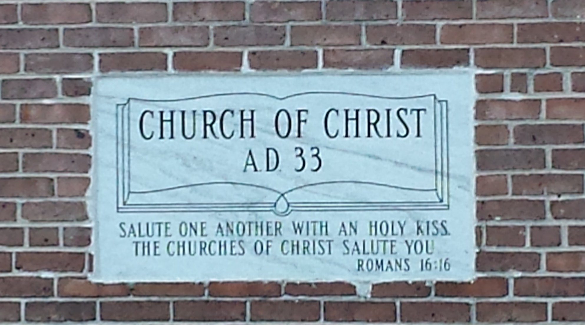
IS THAT TRUE?

Slide 5

Head
1 Corinthians 12:12-13a
“For as the body is one and has many members, but all the members of that one body, being many, are one body, so also is Christ. For by one Spirit we were all baptized INTO one body—whether Jews or Greeks, whether slaves or free…”
Obedience
Acts 2:36-38
2:40 - 41
2:47
Christ
Through
Faith
Eph.
2:8-9
How?
Body
GOD ADDS YOU
Love
Grace
Mercy
Sacrifice
One
Church

Slide 6
But a local church…
Head
You Join
Acts 9:26-28
Acts 18:26-19:1
Christ
How?
You join and they may accept/deny
a local
church
Already IN
Christ’s church

Slide 7
Local Church
(ex. Olsen Park)
Universal Church
(Lord’s Church)
1960’s, families, Amarillo
30’s AD, Christ, No Address
Seek to join or start
God Adds You
Alive
Alive and Dead
Partnership/Fellowship
Lone Members exist
Specific Number
No known number
Saved/Not Saved
Only Saved

Slide 8

I wrote something to the CHURCH; but Diotrephes, who loves to be first among them, does not accept what we say. For this reason, if I come, I will call attention to his deeds which he does, unjustly accusing us with wicked words; and not satisfied with this, he himself does not receive the brethren, either, and he forbids those who desire to do so and puts them out of the CHURCH.
Christ
a local church of Christ
3 John 9-11

Slide 9
Put OUT of the (local) CHURCH… but still in THE church of Christ (God’s saved group of people, cf. 2 Tim. 2:19)
Christ
3 John 9-11
a local church of Christ

Slide 10
Local Church
(ex. Olsen Park)
Universal Church
(Lord’s Church)
1960’s, families, Amarillo
30’s AD, Christ, No Address
Seek to join or start
God Adds You
Alive
Alive and Dead
Partnership/Fellowship
Lone Members exist
Specific Number
No known number
Saved/Not Saved
Only Saved
Invention in between: a system/grouping of churches with the “official name” (denomination)

Slide 11

The ONE TRUE Church is made up of “churches of Christ?”
Head
Head
Christ
Christ
A denomination
Body
Body
One Church
Colonies CoC
University CoC
S. Amarillo CoC
Olsen Park?

Slide 12
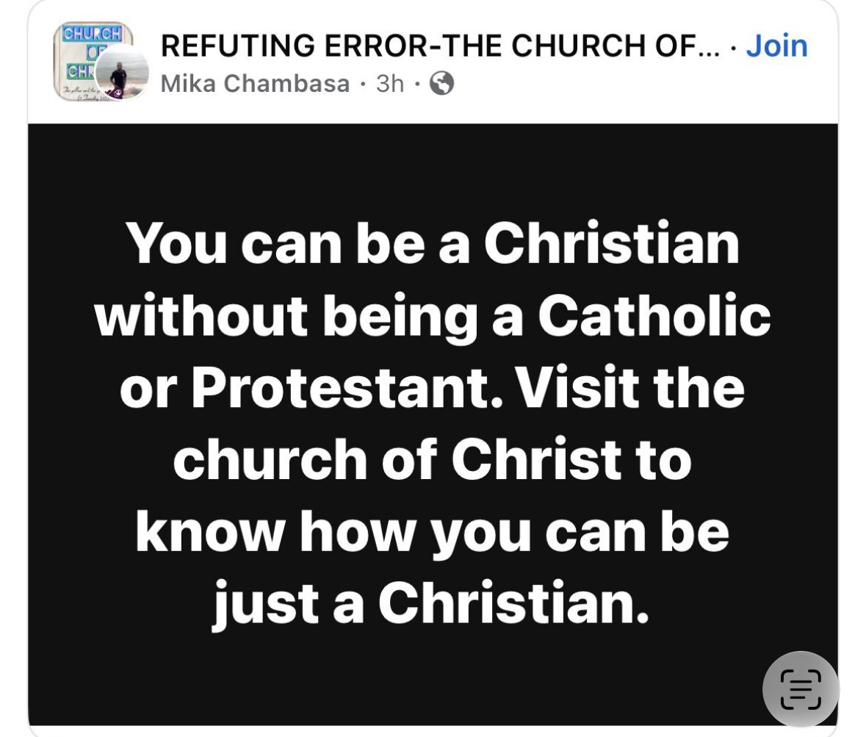
I thought the church of Christ wasn’t a denomination?
Head
Christ
Body

Slide 13
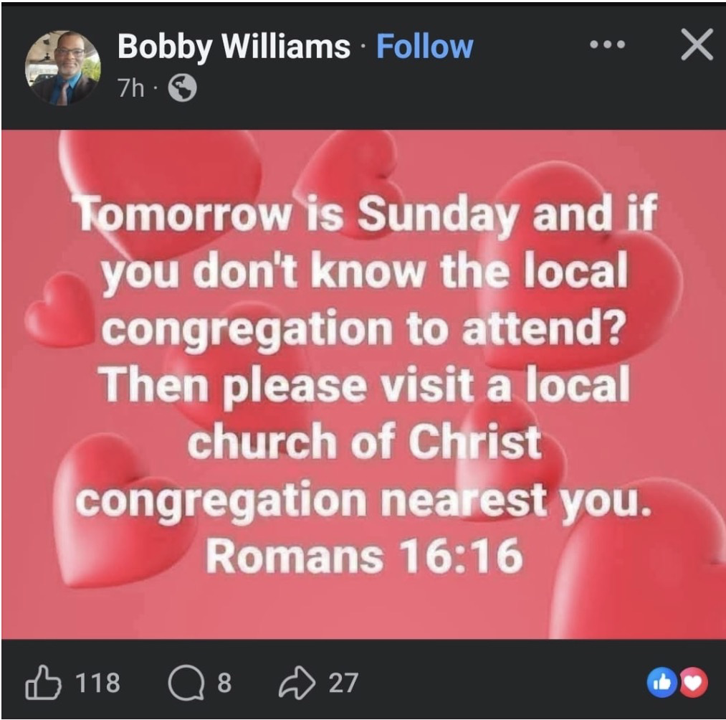
I thought the church of Christ wasn’t a denomination?
Head
Christ
Body

Slide 14
I thought the church of Christ
wasn’t a denomination?
Head
Christ
Body
One Church
Colonies CoC
University CoC
S. Amarillo CoC
Etc.
Campuses/congregations of the denomination

Slide 15
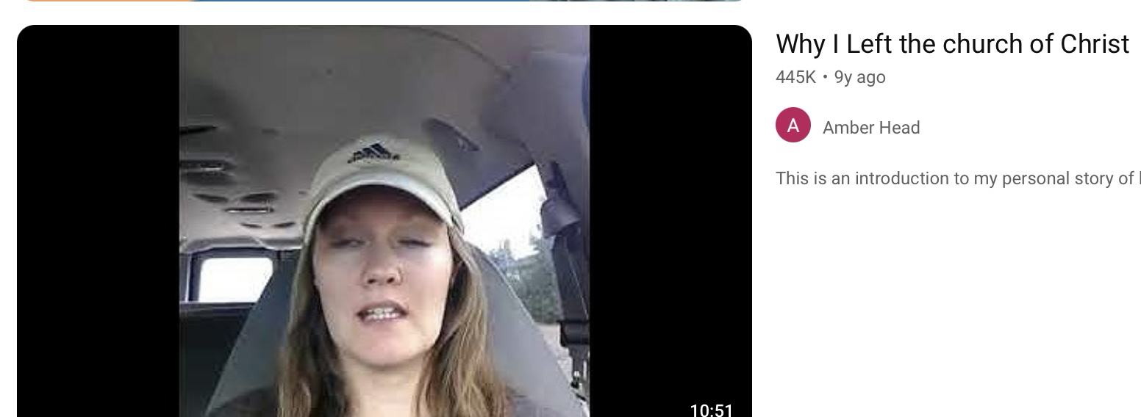
I thought the church of Christ
wasn’t a denomination?
Head
Christ
Body
One Church
Colonies CoC
University CoC
S. Amarillo CoC
Etc.
“I was raised in the church of Christ. It’s a denomination that considers itself non-denominational. There are lots of different strands of it you’ll find some churches that are more strict and others more liberal.”
Campuses/congregations of the denomination

Slide 16
Can one be a Christian and not a part of THE church of Christ?
Yes, they can be part of the church of God, church of God in Christ, etc. they do not have to subscribe to one particular title to be recognized by God.
But no…
Remember “church” just means group of people. Christian but not Christ’s people? Nonsense.

Slide 17


Can one be a Christian and not a part of a church of Christ?
Yes, they can be part of a church of God, a church of God in Christ, etc… the local group does not have one biblical designation to be known by God. (L3).

Slide 18
Can one be a Christian and not a part of a church of Christ?
But no in another sense…to remain faithful?
Remember “church” just means group of people. Christian, but joined themselves to people who aren’t “of” Christ?
What does “of” Christ mean? Belonging to and abiding in.

Slide 19
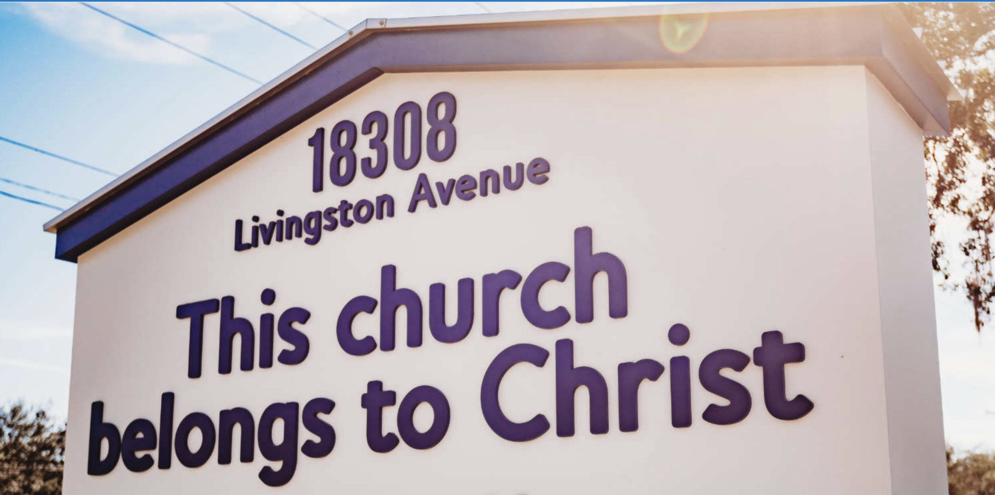
Can one be a Christian and not a part of a church of Christ?
But no in another sense…to remain faithful?
Remember “church” just means group of people. Christian, but joined themselves to people who aren’t “of” Christ?
What does “of” Christ mean? Belonging to and abiding in.

Slide 20
Are there Christians in all the churches (denominations)?
Yes, there could be. In one sense.
But no in another sense of faithfulness… allegiance to men will take you away from the Lord. (Brother in error)
Remember “church” just means group of people. Are these people “of” Christ? Are they actual Christians? Disregarding His teachings?

Slide 21
Can you become a Christian not being baptized IN a “church of Christ”
Similar concept. So much confusion.
What do they mean? In a building? That’s not the church.
In a local assembly? No example of IN one.
I think they mean at one of the branch locations of the denomination.
Yes, we are added to Christ’s church by faith not a system or proximity to other Christians.

Slide 22
Is the Church of Christ the closest to the New Testament pattern?
No, because THE church of Christ does not assemble; worship; or work together.
When someone asks that they aren’t asking about a local church either.
They are asking: among the denominations, which one is the closest? (Or we may even state that sometimes - they/we/our/us)
I can’t answer this question because they are talking about something different.

Slide 23
Can you be raised “in the church?”
Confusion. (+ among denominational friends)
What could that possibly mean?
  Raised in the universal church? (Jer. 31:34)
  Raised in the local church? (1 Cor. 1:2) or??
  Doesn’t make sense biblically at all to say that.
What people hear? Raised in my “CoC” denomination. Raised CoC. It betrays us.
Alternatives: home life, parents, faith, the word.
Affects our view of Baptism: not an initiation into the local church; rite of passage.

Slide 24
Does our church help poor people in the community, orphans, etc.?
I hope so! When do we leave Olsen Park?
James 1:27 – “not a part of the Olsen Park church. I promise!”
The question is not IF we do, But “HOW?”
  Individually through sacrifice (Heb. 13:16)
  Or collected/pooled funds
No authority for a “powerhouse of benevolence.” Pool —> poor saints/preachers L8

Slide 25
Does our church have meals? Donuts and coffee?
Of course, many people have meals together at Olsen Park! We do life together as a local church.
Do you mean from the collected pool of resources down at the meeting place? No, no authority for that.
From that fund we can worship, preach and teach the gospel. They didn’t purpose social events in the NT with those.

Slide 26
Why can’t we send some money to a service organization? What’s the deal?
Q: did God authorize anything larger than a local church to manage it’s funds?
Q2: if men create something larger, what does it require?
Answer: a denomination with doctrinal alignment (a system of churches who agree)
Example:

Slide 27
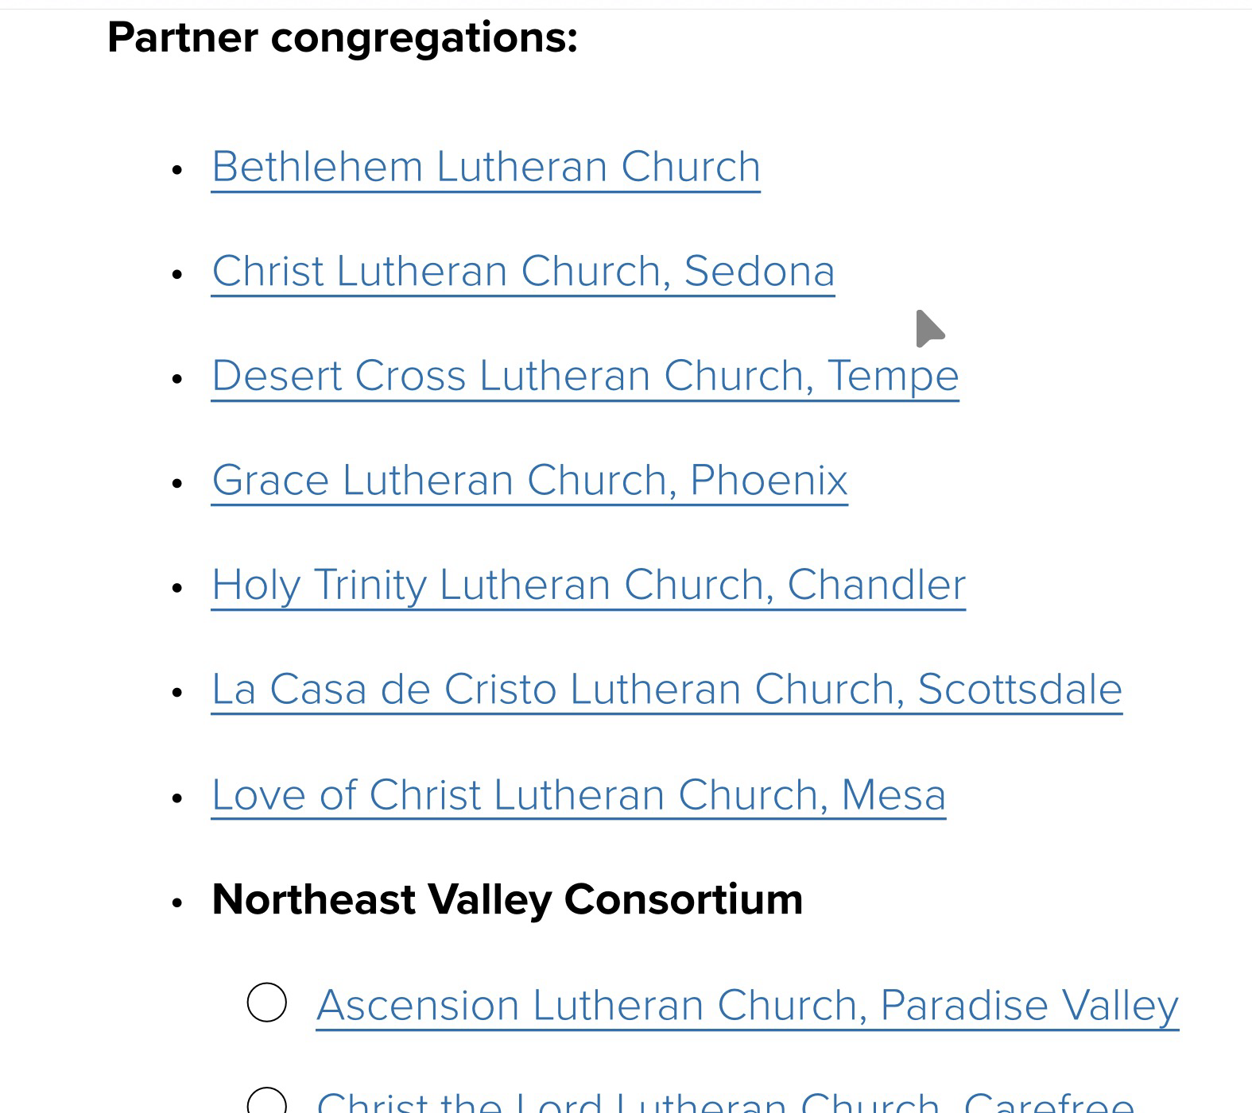
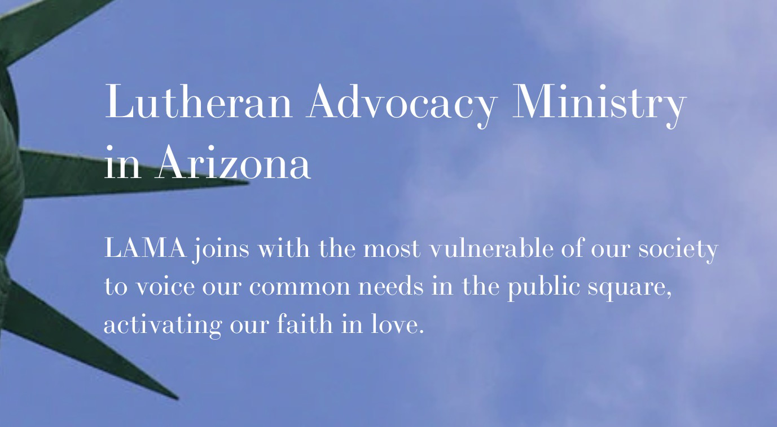
Why can’t we send some money to an organization?

Slide 28

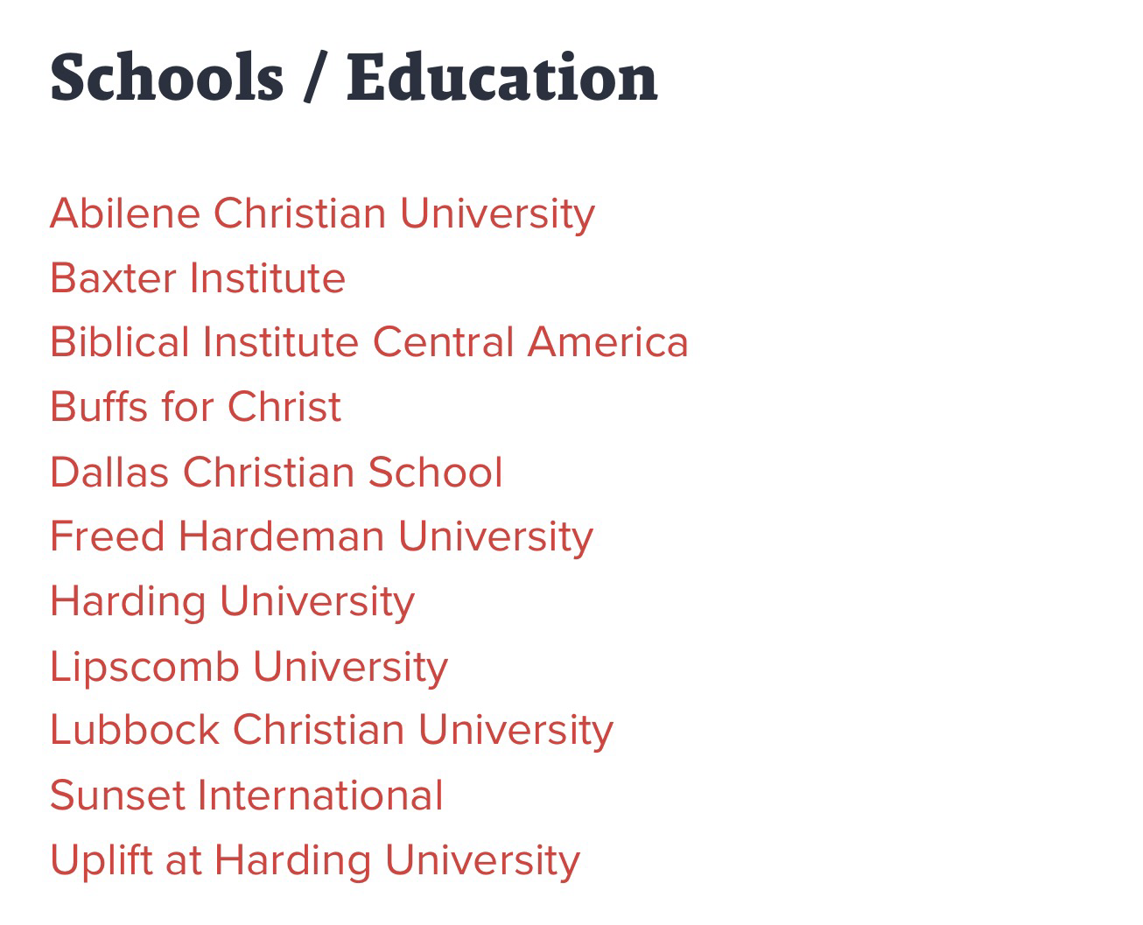
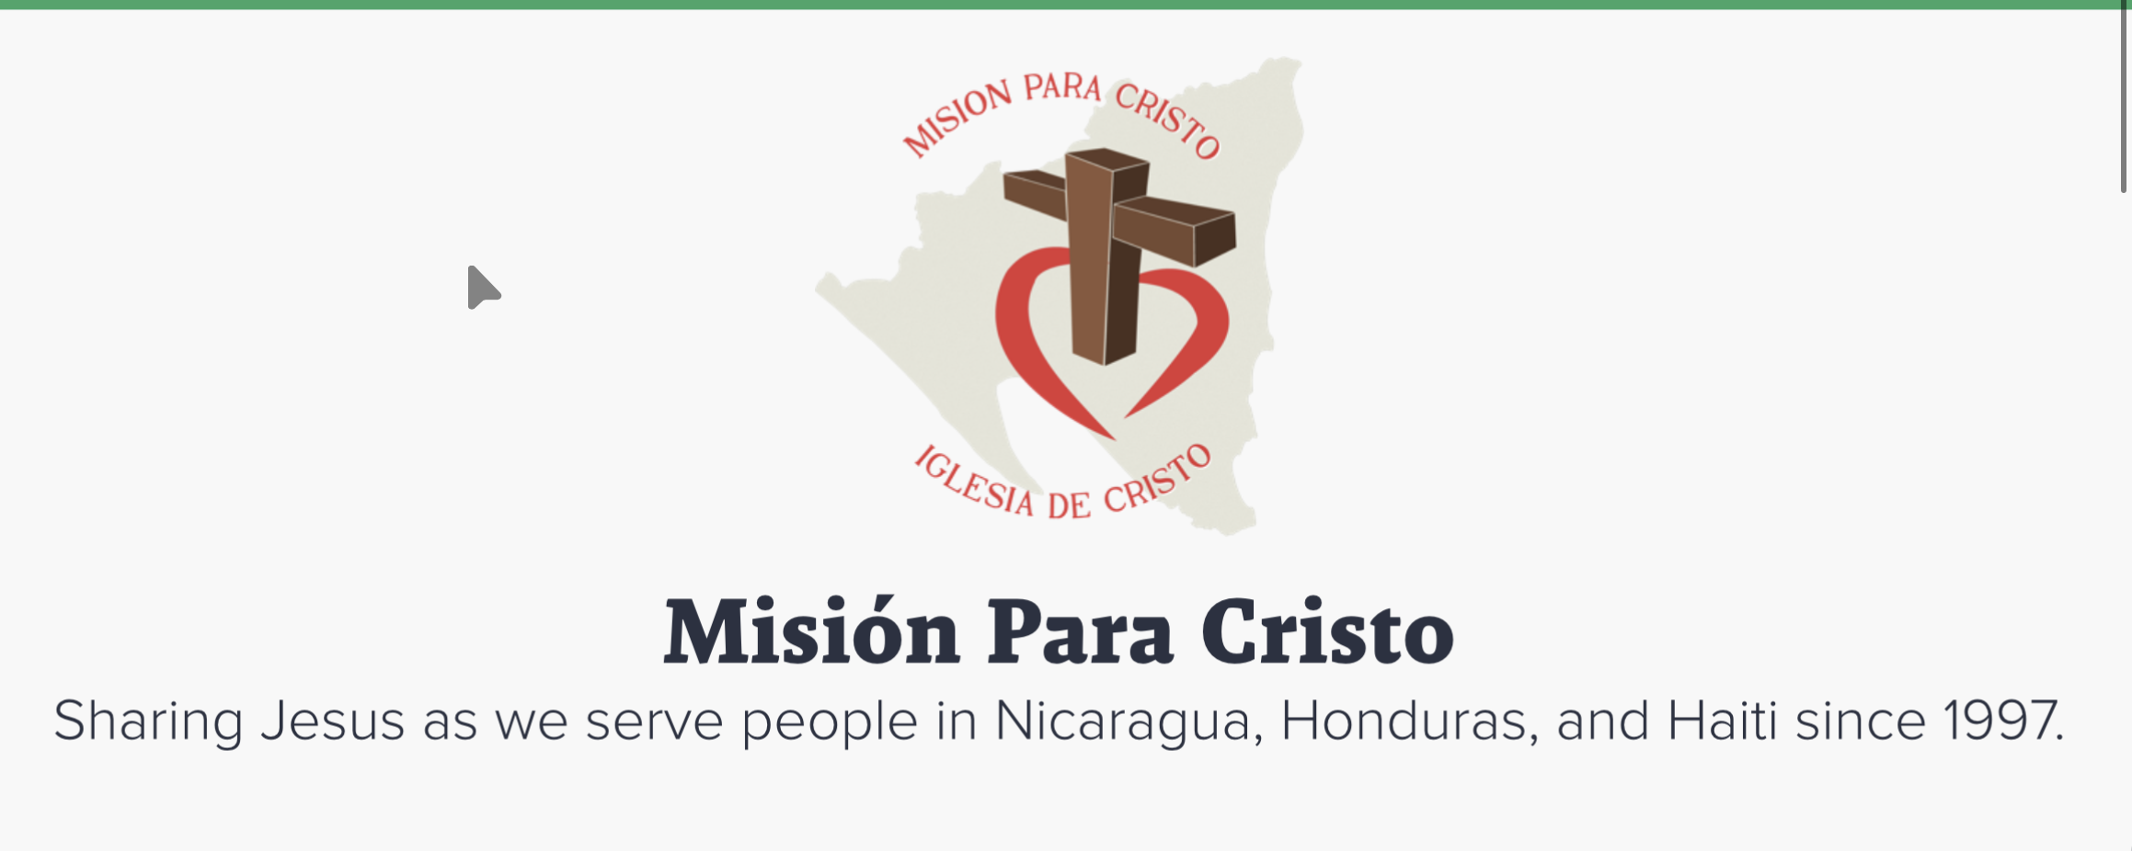
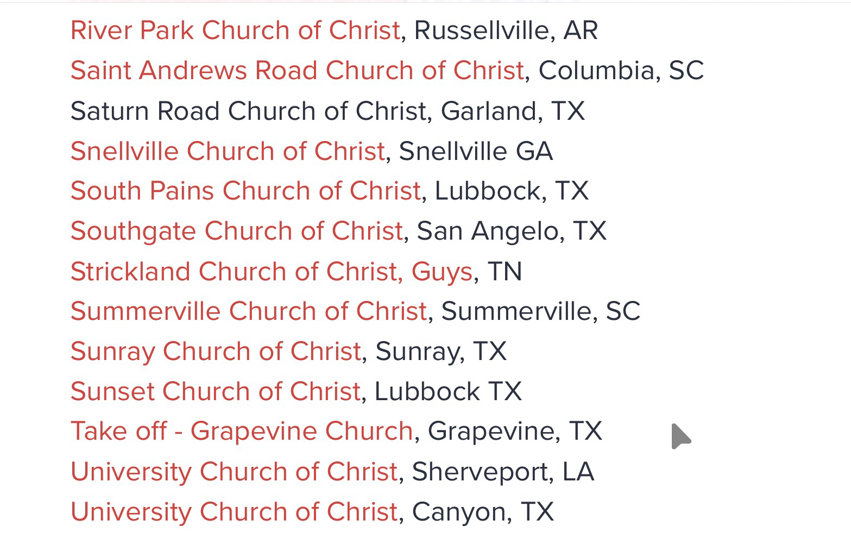
Why can’t we send some money to an organization?
Because we aren’t part of a coc denomination

Slide 29
In review, besides the universal...
There’s only 2 kinds of churches:
What will we be?
Team of Churches
Church B
Church D
Church A
Church C
Independent local church
Denominational local churches
Notes:
However, you cannot follow the apostles doctrine and walk in the light and be on your own. Let’s look at a few passages (many others we could look at)

